Slide 1
Movie API Analysis
An insight into Movie Runtime ,Awards & Nominations
Avernell Christopher-Melikhov
28/11/2023

Slide 2
Overview
The data used consists of 10 Oscar winning movies showing their Genre, Runtime, Award wins,Award Nominations and Box Office earnings.
Primary Focus:
# Analyzing movie runtime
# Identifying the longest runtime
# Understanding the correlation between Runtime and Awards wins /nominations.
# Analyzing Award Wins and Award Nominations

Slide 3
List of Movies
Movie Title | Runtime(mins) | Genre | Award Wins | Award Nominations | Box Office($)
Green Book | 130 | Biography,Comedy,Drama | 3 | 58 | 85080171
The Shape of Water | 123 | Drama, Fantasy, Romance | 4 | 136 | 63859435
Moonlight | 111 | Drama | 3 | 231 | 27854932
Spotlight | 129 | Biography, Crime, Drama | 2 | 124 | 45055776
Birdman or (The Unexpected Virtue of Ignorance) | 119 | Comedy, Drama | 4 | 192 | 42340598
12 Years a Slave | 134 | Biography, Drama, History | 3 | 242 | 56671993
Argo | 120 | Biography, Drama, Thriller | 3 | 95 | 136025503
The Artist | 100 | Comedy, Drama, Romance | 5 | 162 | 44671682
The King's Speech | 118 | Biography, Drama, History | 4 | 108 | 138797449
Parasite | 132 | Drama, Thriller | 4 | 306 | 53369749

Slide 4
Movie Runtime
Mean Runtime: 121.6 minutes
Median Runtime: 121.5 minutes
Lowest Runtime: 100 minutes - “The Artist”
Highest Runtime: 134 minutes - “12 Years a Slave” - Longest movie
Standard Deviation of Runtime: 10.490207073477837

Slide 5
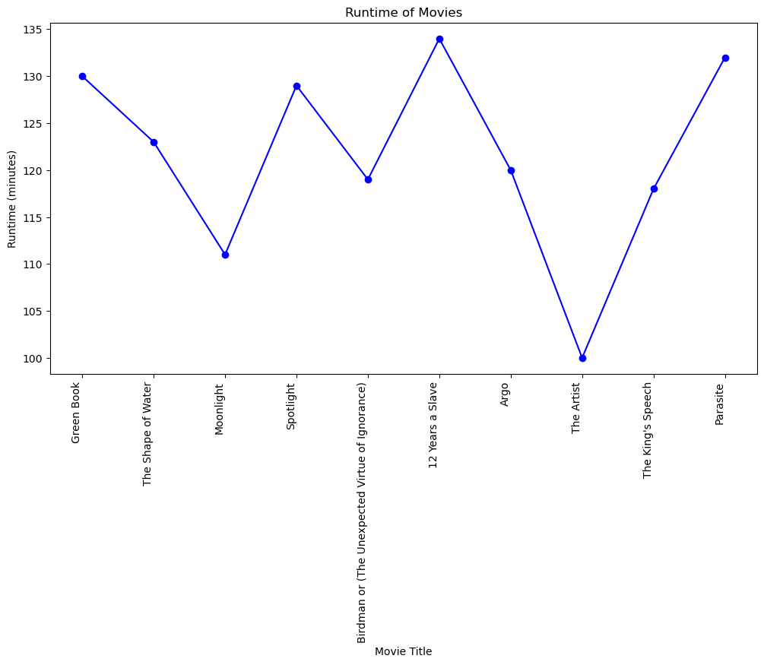
A Line graph showing the runtime for each movie

Slide 6
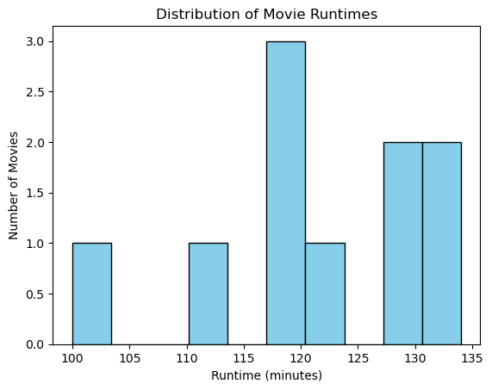
The majority of movies run between 117 and 120 minutes of Runtime time

Slide 7
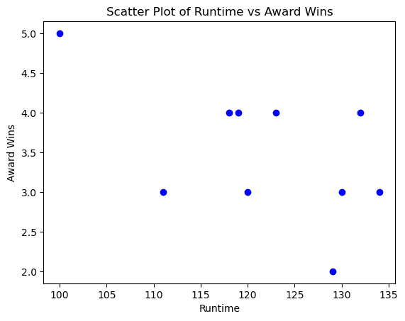
The scatter plot below shows a clear negative correlation between Runtime and the number of awards a movie has won.

Slide 8
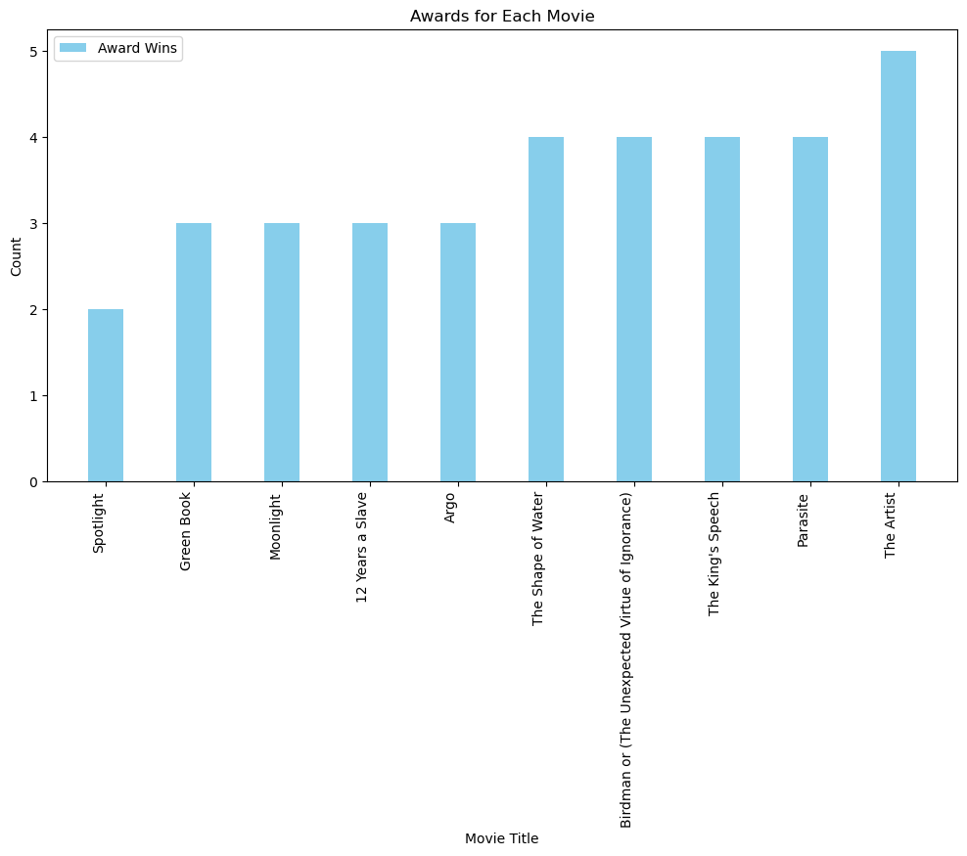
A Bar graph showing the number of Awards won by each movie

Slide 9
From the data, the following was calculated:
Average/Mean Award Wins : 3.5
Median Award Wins: 3.5
Least Award Wins: 2 - “The Artist”
Most Award Wins: 5 - “Spotlight”

Slide 10
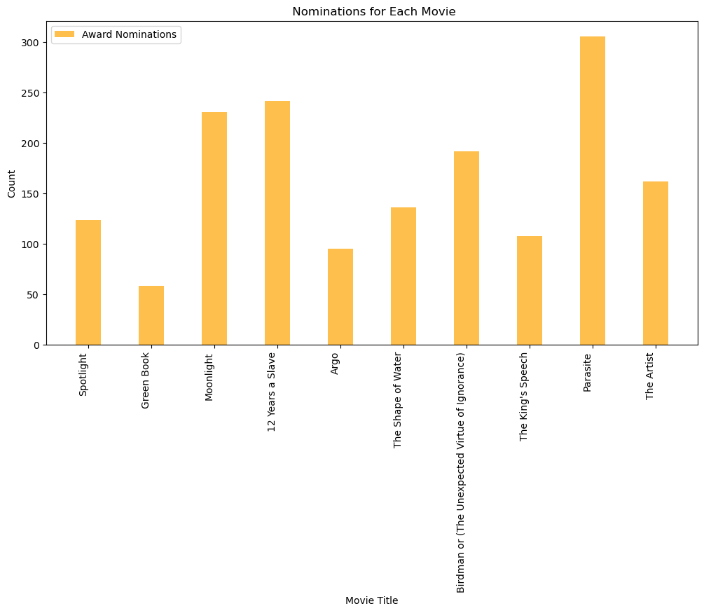
A bar graph showing the number of Award Nominations for each movie

Slide 11
From the data, the following was calculated
Mean Award Nominations : 165.4
Median Award Nominations: 149.0
Least number of Award Nominations: 58 - “Green Book”
Most Award Nominations: 306 -”Parasite”

Slide 12
Conclusion
No correlation between runtime ,award wins or award nominations were detected.Other factors contribute to a film’s overall award wins and nominations such as genre.
Key Findings:
Most movies have an average runtime 117 to 121 minutes.
The average award wins is 3.5 awards.

Slide 13
THE END OF THE PRESENTATION

